Slide 1
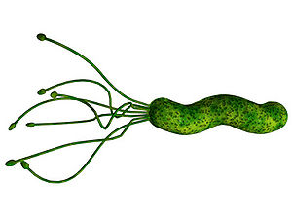
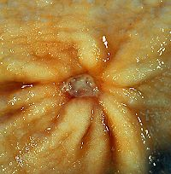
Peptic Ulcer Disease Microbiological aspect
Dr. Nadisha Badanasinghe
Senior Lecturer

Slide 2
Case presentation
A 40-year-old man presents to his GP with a 2-month history of intermittent upper abdominal pain. The pain sometimes wakes him at night, is relieved by food and drinking milk.
He had a similar but milder episode about 5 years ago.
Not on any long term medications/ no family history. Social drinker, non smoker.
Physical examination reveals a fit, apparently healthy man.
The only abnormal finding is mild epigastric tenderness on palpation of the abdomen

Slide 3
D/D
Diagnosis
Management

Slide 4
Objectives
Microbiology of H.pylori
Morphology and culture characteristics
Epidemiology
Transmission
Virulance factors
Pathogenesis
Clinical presentations
Diagnosis
Invasive methods
Non-invasive methods
Treatment

Slide 5

History

Slide 6
History
Was widely believed that PUD was caused by excess acid in the stomach (hyperacidity theory)
Over past 30 years, acid control was the primary method of treatment for PUD, with only partial success.
This belief was altered when two scientists Warren and Marshall effectively proved Koch's postulates for causation of PUD by H. pylori through a series of experiments in the 1980s

Slide 7
History
Marshall intentionally consumed H. pylori and became ill. He took antibiotics and was relieved of his symptoms.
Now, it is agreed that H. pylori is the primary nondrug cause of PUD, and recommend treatment to eradicate it.
In 2005, Barry Marshall and Robin Warren were awarded the Nobel Prize in Physiology or Medicine for their discovery that peptic ulcer disease (PUD) was primarily caused by Helicobacter pylori

Slide 8



The Nobel Prize in Physiology or Medicine 2005
"for their discovery of the bacterium Helicobacter pylori and its role in gastritis and peptic ulcer disease"
Barry J. Marshall
Australia
J. Robin Warren
Australia
b. 1951
b. 1937

Slide 9
Helicobacter pylori
Belongs to order Campylobacterales
Gram-negative rod, spiral bacterium
Has 2 to 6 unipolar, sheathed flagella - highly motile
Produces
oxidase
catalase
urease (Very high urease activity)
Lives only on gastric mucosa (or gastric metaplasic mucosa)- on the mucous layer
Do not invade mucosa
Mainly resides in gastric antrum

Slide 10
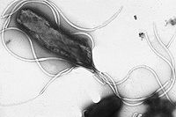
Electron micrograph of H. pylori

Slide 11
Helicobacter pylori
The first formally recognized bacterial carcinogen
Grp 1 carcinogen
Detected in >75% of MALT lymphoma
Higher gastric cancer with a higher prevalence of H. pylori
One of the most successful human pathogens
Over half of the world's population is colonized
Able to colonize the acidic gastric environment, although the bacterium is not an acidophile

Slide 12
Helicobacter pylori- Disease Types
Etiology of various gastrointestinal diseases
chronic active gastritis
Functional dyspepsia (20-60%)
peptic ulceration
gastric ulcers (50%)
duodenal ulcers (80%)
gastric adenocarcinoma
gastric MALT lymphoma
? GERD - occur independently of H. pylori colonization

Slide 13
Helicobacter pylori- Other Associations
ITP
Iron deficiency anaemia
Vit. B12 deficiency
Coronary artery disease
Metabolic syndrome
Neuro-degenerative disease
Diabetes
Pre-eclampsia

Slide 14

Prevalence and Geographical Distribution
Very high prevalence in developing countries
more than 80% of the population is H. pylori positive, even at young ages
Prevalence in industrialized countries generally remains under 40% and low in early childhood and slowly rises with increasing age
Inversely correlates with socioeconomic status
Increase with poor living conditions during childhood
In SL - prevalence ~ 70%

Slide 15
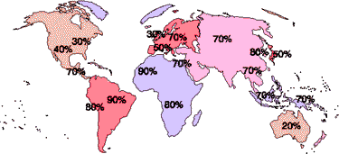

Slide 16
Transmission and Sources of Infection
The exact mechanisms are largely unknown
Found almost exclusively in humans and some nonhuman primates (narrow host range)
Occur from direct human-to-human transmission
Oral-oral or fecal-oral route or both
It has been detected in saliva, vomitus, gastric refluxate, and feces
?through food and water
Acquisition mostly occurs in early childhood, most likely from close family members
Overcrowding and poor socioeconomic status are risk factors

Slide 17
Growth requirements
Microaerophilic
optimal growth at O₂ levels of 2 to 5% and 5 to 10% CO₂
Optimum growth at 37°C
Fastidious microorganisms
Requires complex growth media supplemented with blood or serum
Columbia or Brucella agar supplemented with either (lysed) horse or sheep blood PLUS selective antibiotic mixtures

Slide 18
Virulence factors - for survival
Spiral shape
Motility
Urease
converts urea into ammonia
Allow survival in the highly acidic gastric lumen
Attachment
To phospholipids, glycoproteins and Lewis B Ag of Blood grp O people
Facultative intra-cellular organism
Interfere with phagosome maturation

Slide 19
Virulent Factors- for pahogenicity
Vacuolating toxin (Vac A)
forming vacuoles
Cytotoxin associated gene A (cag A) protein
highly immunogenic protein encoded by the cagA gene
CagA⁺ only present with Vac A cytotoxic effect
Duodenal ulcer promoting gene A (dupA)
Associated with duodenal ulcer
Increased gastrin secretion

Slide 20
Pathogenesis
Colonization inflammation gastritis (observed in all H. pylori-positive subjects, but often asymptomatic)
Secrete toxins vacuolation and inflammation ulcer disease and gastric cancer
Severity of this chronic inflammatory process depends on a variety of factors
characteristics of the colonizing strain, host genetics and immune response, diet, and the level of acid production
Infection with other gut bacteria (Prevotella, Streptococcus)/ SIBO

Slide 21
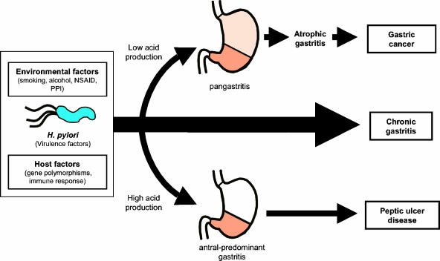

Slide 22
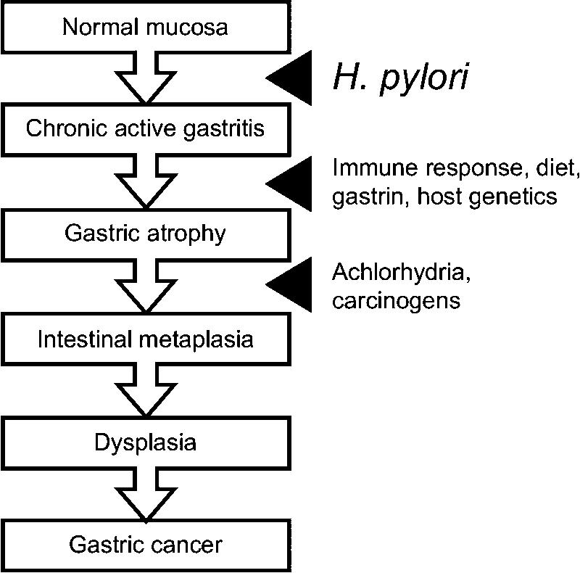

Slide 23
Host immunity
The first line of defense is mucus, bicarbonate secretion and epithelial barrier
Antibodies - prevent infection and reduce colonization in animal models
Th1 CMI - principal role in sterilizing immunity
H. pylori-induced gastritis and/or pathology depends predominantly on Th1 cells and Th1 cytokines

Slide 24
Other Risk Factors for PUD
Non Steroidal Anti-inflammatory Drugs
Steroid therapy
Smoking
Excess alcohol intake
Male: female = 4:1
Genetic factors
Zollinger Ellison syndrome – rare syndrome caused by gastrin-secreting tumour
Blood group O (DU)/ A (GU)
Hyperparathyroidism

Slide 25
Clinical features
Epigastric pain
gnawing or burning
awakens the patient at night
Nausea
belching, dyspepsia
flatulence, bloating, distension
Heartburn
Haematemesis, &/or melena

Slide 26
Alarm features
Bleeding
Anemia
extreme, stabbing pain
unexplained weight loss, LOA, palpable mass/ LN
progressive dysphagia
recurrent vomiting
family history of GI cancer

Slide 27
Complications
Bleeding from ulcers
Gastric/ duodenal perforation
Gastric outlet obstruction
Gastric carcinoma

Slide 28
D/D for epigastric pain
Surgical
Biliary colic, acute cholecystitis
Pancreatitis
Perforation of viscus
Acute appendicitis
Medical
GERD
MI
PE
Pneumonia

Slide 29
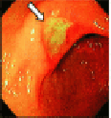
Diagnosis of H. pylori infection
Invasive methods
Biopsy from endoscopy
Non-invasive methods
Breath test
Blood tests

Slide 30
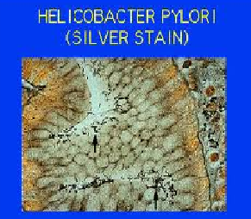
Invasive methods- endoscopic biopsy specimen
Histology
Silver stain/ H& E
“Gold standard” in routine hospital diagnostics
Sensitivity and -93-96%
Specificity – 98-99%
provides histological data on inflammation and atrophy
Requires expert pathologist

Slide 31
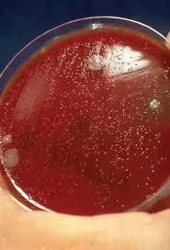
Invasive methods- endoscopic biopsy specimen
Culture
Alternative gold standard
Sensitivity – 80-98%
Specificity – 100%
Can do ABST/ typing
Isolation is difficult and not always successful.
Cultures should be inspected from day 3 to day 14
H. pylori forms small (~1-mm), translucent, smooth colonies

Slide 32

Invasive methods- endoscopic biopsy specimen
3. Rapid biopsy urease test /CLO test
Bed side test, cheap, simple
Place biopsy in urea broth
Sensitivity- 88-95%%
Specificity – 95-100%

Slide 33
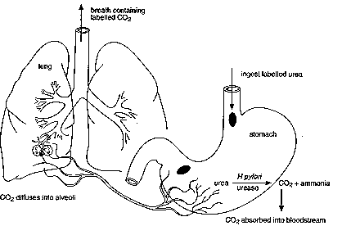
Non-invasive tests
Urea breath test
A capsule of urea labelled with C¹⁴
Measure C¹⁴ in breath
Sensitivity – 90-96%%
Specificity – 88-98%
Very useful, reliable test to evaluate success of eradication treatment of H. pylori
limited availability due to requirement of expensive equipment

Slide 34
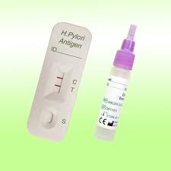
Non-invasive tests
2. Fecal antigen test
Not widely used yet
Simple test
may not be reliable for evaluation of success of eradication treatment of H. pylori
Sensitivity -92%
Specificity – 94%

Slide 35
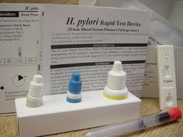
Non-invasive tests
3. Serology –ELISA
Detect Abs
Mainly used for epidemiological studies
Insufficient reliability for routine screening
cannot prove ongoing infection due to immunological memory
Sensitivity -80-90%
Specificity 70-88%

Slide 36
Treatment
Prevents recurrence of ulcers
Although H. pylori is sensitive to a wide range of antibiotics in vitro, they all fail as monotherapy in vivo
This is related to the niche of H. pylori, residing at lower pH
The most effective single drug is clarithromycin
eradication rate of 40% when given twice daily for 10 to 14 days
Triple therapies
combining twice-daily-dosed PPI with Two antibiotics

Slide 37
Treatment
Antibiotics effective
macrolides (clarithromycin, sometimes azithromycin)
Tetracycline
Amoxicillin
imidazoles (metronidazole and tinidazole)
Triple therapies
Use a PPI + amoxicillin 1g +clarithromycin 500 mg regimen
(b.d dose for 14 days)
or
PPI + metronidazole 500mg + clarithromycin 500mg regimen
(b.d dose for 14 days)

Slide 38
Treatment
Various treatment durations, doses, and drug combinations have been studied, but none have consistently reached eradication levels in excess of 90 to 95%
Treatment failures
Due to insufficient therapy adherence, often because of side effects,
Due to the presence of antimicrobial resistance
Clarithromycin resistance
Ulcers can recur in the absence of successful H pylori eradication

Slide 39
Prevention
Increasing amounts of antimicrobial resistance in H. pylori have created the need for a prevention strategy.
Scientists have conducted extensive vaccine studies using mouse models that have shown promising results
Dietary measures
Probiotics - prevent infection with pathogenic bacteria
Improvement of living conditions and life style change

Slide 40
Summary
Microbiology of H. pylori
Epidemiology
Pathogenesis and clinical presentations
Diagnosis
Treatment

